Slide 1
TOP CALCULATOR
ALU
‘
SYS_CLK
ADD
SYS_RESET_B
DATA_A[7:0]
START
(START = ‘1’ & OP_CODE = “001”/
A_temp <= Acon;
B_temp <= Bcon;
add_sub <= ‘0’;)
DATA_B[7:0]
OP_CODE[2:0]
ELSE
DATA_C[15:0]
INIT
(START = ‘1’ & OP_CODE = “010”/
A_temp <= Acon;
B_temp <= Bcon;
add_sub <= ‘1’;)
SUB
END_OP
(start = ‘0’)
(START = ‘1’ & OP_CODE = “100”/
A_temp <= (others => '0');
B_temp <= (others => '0’);
add_sub <= '0’;)
MUL

Slide 2
ALU
‘
ADD
MUL
SUB
INIT
S1
S16
S2
S15
S3
S14
S4
S13
S5
S12
S6
S11
S7
S10
S8
S9

Slide 3
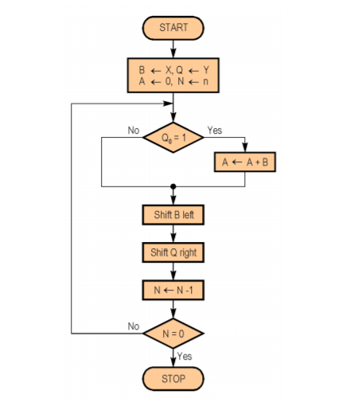
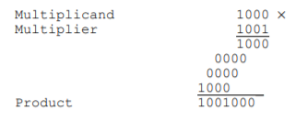
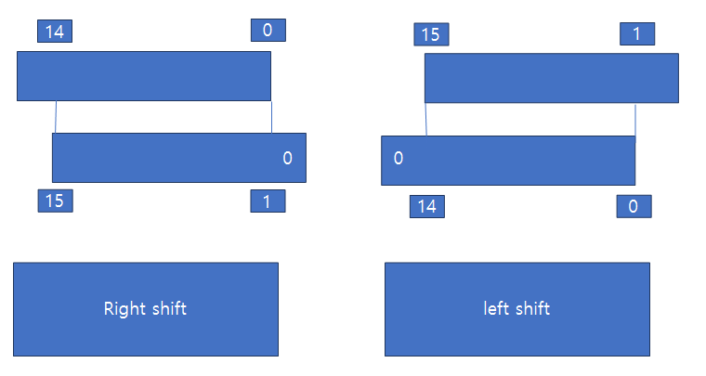
ALU
A_temp <= (others => '0');
B_temp <= (others => '0');
s1
A
B

